Slide 1
Week 11
Stored Procedures

Slide 2
Procedures / Like Functions
Procedures are very similar to functions:
They are made to perform a specific task, such as data manipulation or calculations
They are reusable and encapsulate logic to simplify complex operations
They accept input parameters and return outputs
They are especially useful for:
Automating repetitive tasks
Enforcing business rules to promote data integrity
Centralizing logic for consistency

Slide 3
Procedures / But Not Functions
Procedures do not need a return value
In other words they can act like void functions if you would like them to
Procedures are a lot more flexible
They can be used to perform multiple tasks at a time, like inserting into multiple tables and their bridge table in 1 procedure call

Slide 4
Procedures
Syntax
DELIMITER //
CREATE PROCEDURE procedure_name (IN param1 INT, OUT param2 INT)
BEGIN
-- procedure body
END //
DELIMITER ;
procedure declaration
procedure body
Also like functions, procedures have a declaration and a body

Slide 5
Procedure Declaration
CREATE PROCEDURE procedure_name (IN param1 INT, OUT param2 INT)
procedure_name
name used when calling our function
parameters
Inputs AND outputs to the procedure

Slide 6
Procedure Name
CREATE PROCEDURE procedure_name (parameters);
procedure_name should be descriptive, explain what it does succinctly
Prefix the function using usp_ (meaning user procedure)
As always, follow the naming standard that is already in place
For example: Create a procedure that inserts a new review and retrieves the new average for the reviews movie
CREATE PROCEDURE usp_update_and_get_average_rating
...
*Full code in W11 Example scripts

Slide 7
Procedure Parameters
CREATE PROCEDURE procedure_name (parameters);
For procedures parameters are inputs AND outputs
parameters can be denoted as either IN, OUT, or INOUT
IN - denotes a normal input parameter
OUT - denotes a return variable
INOUT - denotes an input parameter that will also be returned
Example of procedure declaration with IN, OUT, and INOUT parameters
CREATE PROCEDURE usp_update_and_get_average_rating(
INOUT movie_id INT,
INOUT username VARCHAR(255),
IN user_rating DECIMAL(3, 2),
OUT avg_rating DECIMAL(3, 2)
) …
*Full code in W11 Example scripts

Slide 8
Procedure Calls
Procedure calls
All parameters must be included in the call
OUT and INOUT must be session variables to capture returned values
CALL usp_update_and_get_average_rating(@movie_id, @username, @user_rating, @avg_rating);
INOUT movie_id INT,
INOUT username VARCHAR(255),
IN user_rating DECIMAL(3, 2),
OUT avg_rating DECIMAL(3, 2)
SET @movie_id = 1;
SET @username = 'humber_bebis';
SET @user_rating = 4;
SET @avg_rating = NULL;
SELECT @movie_id, @username, @user_rating, @avg_rating;
*Full code in W11 Example scripts

Slide 9
Session Variables
These are session variables
They are temporary variables for a single connection/session
They do not need to be declared, just SET:
SET @movie_id = 1;
SET @username = 'humber_bebis';
SET @user_rating = 4;
SET @avg_rating = NULL;
No data type declaration needed
Used as temporary variables between queries
Automatically destroyed after the session ends
Prefixing with @ helps to easily identify them as session variables

Slide 10
Procedures
Syntax
DELIMITER //
CREATE PROCEDURE procedure_name (IN param1 INT, OUT param2 INT)
BEGIN
-- procedure body
END //
DELIMITER ;
procedure declaration
procedure body

Slide 11
Procedure Body
Syntax
BEGIN
-- declarative section
-- executable section
END //
Same as functions, procedures must declare their variables before creating the executable section

Slide 12
Procedures
Example: Create a procedure that will insert a new movie, with a new director, and connect them with a new record in the movie_director bridge table
Requirements:
Insert new movie data
Insert new director data
Insert new data ids into the movie_director table
*Full code in W11 Example scripts

Slide 13
Procedures Vs. Functions
Does not need to return values
Can return multiple values
Can be used for more complex processes, calculations, data modification (CRUD), etc.
Called independently
Must return a value
Must return a single value
Typically used for calculations and lightweight operations
Called within SQL queries (e.g., SELECT, WHERE)

Slide 14
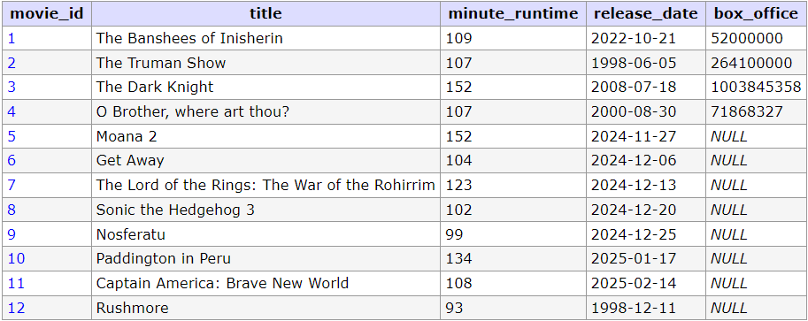
Cursors
A CURSOR allows developers to process query results row-by-row
Cursors must be used within a stored procedure or function
Cursors are useful for operations requiring sequential access to data
Basically, use them when to interact with each row one by one
This row by row process works by looping over each row in a SELECT statements result set

Slide 15
Cursors
To access result sets row by row we need to complete 4 steps
Declare: Define the cursor with a SQL query
Open: Execute the query and initialize the result set
Fetch: Retrieve one row at a time into variables
Close: Release the cursor after processing

Slide 16
Cursors / Declare
Cursor Declaration Syntax
DECLARE cursor_name CURSOR FOR
SELECT select_statement...;
Cursors are similar to iterators, start at top of a list, iterate through one by one
Or in the databases case, row by row
Cursors also require a handler to detect when no more rows are available
Handler Declaration Syntax
DECLARE CONTINUE HANDLER FOR NOT FOUND SET done = 1;
The CONTINUE HANDLER catches any NOT FOUND condition in the procedures scope, including when cursors perform FETCH operations

Slide 17
Cursors / Declare
*Important Note: CURSOR and HANDLER must be declared last in the declaration section, otherwise error will occur
BEGIN
-- declarative section
DECLARE cursor_name CURSOR FOR SELECT select_statement...;
DECLARE CONTINUE HANDLER FOR NOT FOUND SET done = 1;
-- executable section
END //

Slide 18
Cursors / Open
Syntax
OPEN cursor_name;
When executed, the cursor is activated and will perform the following actions:
Executes the SQL query defined in the cursors declaration
Stores the result set of the query that is executed, making each row available for the next step of fetching

Slide 19
Cursors / Fetch
Syntax
FETCH cursor_name INTO variable_1, variable_2, ...;
Fetching gives access to each row, 1 row at a time
Every time a FETCH is executed, the row advances and stores the requested data into given variables
If 1 column is requested in SELECT query, 1 variable is required
If 5 columns are requested, 5 variables are required
etc.
Just like an array, to iterate through all the data we must loop

Slide 20
Cursors / Iterating
Syntax
DECLARE CONTINUE HANDLER FOR NOT FOUND SET done = 1;
...
FETCH cursor_name INTO variable_1, variable_2, ...;
WHILE NOT done DO
-- Row interaction logic
FETCH cursor_name INTO variable_1, variable_2, ...;
END WHILE;
Get the first row to initiate the loop
Then loop until a NOT FOUND error occurs
When that happens, the done variable will flip and the loop will exit

Slide 21
Cursors / Close
Syntax
CLOSE cursor_name;
Close cursors after fetching all rows to free memory and prevent leaks
A cursor can only be opened once and closed once
Best practice is to close cursors at the end of the procedure for efficient resource management

Slide 22
Cursors
Example: Select each movie title row by row
...
DECLARE movie_cursor CURSOR FOR SELECT title FROM movie;
DECLARE CONTINUE HANDLER FOR NOT FOUND SET done = 1;
OPEN movie_cursor;
FETCH movie_cursor INTO movie_title;
WHILE NOT done DO
SELECT movie_title;
FETCH movie_cursor INTO movie_title;
END WHILE;
CLOSE movie_cursor;
...
CALL usp_list_titles();
Declare
Open
Fetch
Close
*Full code in W11 Example scripts

Slide 23
Extra: ON DELETE CASCADE
ON DELETE CASCADE is a constraint used to automatically delete related child table rows when a parent row is deleted
Ensures referential integrity by preventing orphaned records
Used in many-to-one or many-to-many relationships
*See CREATE TABLE code for movie_director and review tables in the db_example_tables.sql

